Slide 1

Titolo presentazione sottotitolo
Structural Reliability of Aerospace Components
Safe-life and Damage Tolerance Analysis of the TP400 Propeller Shaft
Milano, XX mese 20XX
Nikolaos Rigatos
16/01/2024

Slide 2
Contents
2
01
Introduction
02
Results: Part 1
03
Results: Part 2
01
04
Results: Part 3
01
05
Conclusions
Nikolaos Rigatos, Structural Reliability of Aerospace Components, AY 2023/24

Slide 3
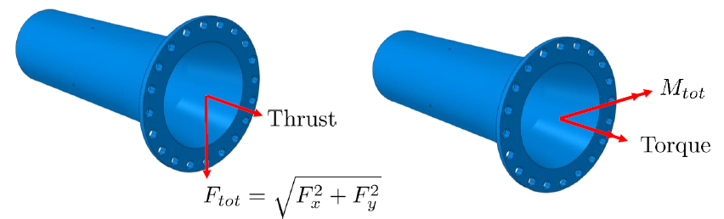
1
1.1
Introduction
Problem Definition
3
The goal of the project is to do a safe-life and damage tolerance analysis of the TP400 propeller shaft, which is a part of the A400M military aircraft.
Assumption: The radial forces generate a moment that is in phase with the bending moment.
During operation:
Torque and thrust generate a mean stress in the section
Bending moment and radial force generate an alternate stress in the section
Nikolaos Rigatos, Structural Reliability of Aerospace Components, AY 2023/24

Slide 4
1
1.2
Introduction
Data
4
Stress history data
Fatigue data (1)
The stress history (alternate and bending stress) of three mission profiles is given. The stresses are given as local values.
S [MPa] | N [cycles] | Run-out?
750 | 20924 | 0
750 | 19515 | 0
750 | 20012 | 0
750 | 31092 | 0
750 | 26412 | 0
650 | 83565 | 0
650 | 65788 | 0
650 | 67308 | 0
650 | 58303 | 0
650 | 110779 | 0
550 | 391092 | 0
550 | 356807 | 0
550 | 308519 | 0
550 | 276038 | 0
550 | 370768 | 0
450 | 2000000 | 1
450 | 1582332 | 0
450 | 1696395 | 0
450 | 1855152 | 0
450 | 1412137 | 0
Material data
AISI430 steel | Value
Elastic modulus [MPa] | 210000
Poisson’s ratio [-] | 0.3
Yielding stress [MPa] | 972.2
UTS [MPa] | 1103
KIc [MPa m^{1/2}] | 112.1
Nikolaos Rigatos, Roberto Dario Benvenuto Moreno Structural Reliability of Aerospace Components, AY 2023/24

Slide 5
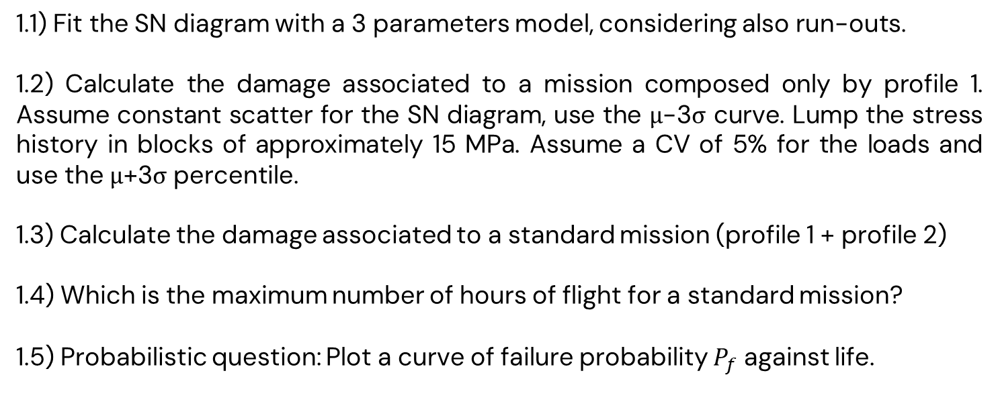
1
1.3
Introduction
Tasks
5
Part 1
Safe-life assessment
1.1) Fit the SN diagram with a 3 parameters model, considering also run-outs.
1.2) Calculate the damage associated to a mission composed only by profile 1. Assume constant scatter for the SN diagram, use the μ-3σ curve. Lump the stress history in blocks of approximately 15 MPa. Assume a CV of 5% for the loads and use the μ+3σ percentile.
1.3) Calculate the damage associated to a standard mission (profile 1 + profile 2)
1.4) Which is the maximum number of hours of flight for a standard mission?
1.5) Probabilistic question: Plot a curve of failure probability $P_{f}$ against life.
Nikolaos Rigatos, Structural Reliability of Aerospace Components, AY 2023/24

Slide 6
1
1.3
Introduction
Tasks
6
Part 2
Deterministic damage-tolerance assessment
2.1) Determine the critical crack size using the EPFM theory.
2.2) Find the maximum number of missions for profile 1. Lump the signal and randomize the sequence.
2.3) Find the maximum number of standard missions (profile 1 + profile 2). Lump the signal and randomize the sequence.
2.4) If the target life of 3000h is not met, find the number of inspections ensuring a failure probability compliant with regulations (2e-5). Use the POD curves in the Advisory Circular AC-70.2.
Nikolaos Rigatos, Structural Reliability of Aerospace Components, AY 2023/24

Slide 7
1
1.3
Introduction
Tasks
7
Part 3
Probabilistic damage tolerance assessment
3.1) Starting from the anomalies distribution for circular holes in the AC 33-70.2, perform a probabilistic damage tolerance assessment, considering that we have 8 holes on each of the 4 shafts (weakest link). Which is the life with a probability of being exceeded of 2e-5 considering only Profile 1? And which for a standard mission?
3.2) If the target failure probability is not ensured, apply an inspection plan in a probabilistic framework. Use a Monte Carlo simulation according to the scheme proposed in the AC 33-70.2.
Nikolaos Rigatos, Structural Reliability of Aerospace Components, AY 2023/24

Slide 8
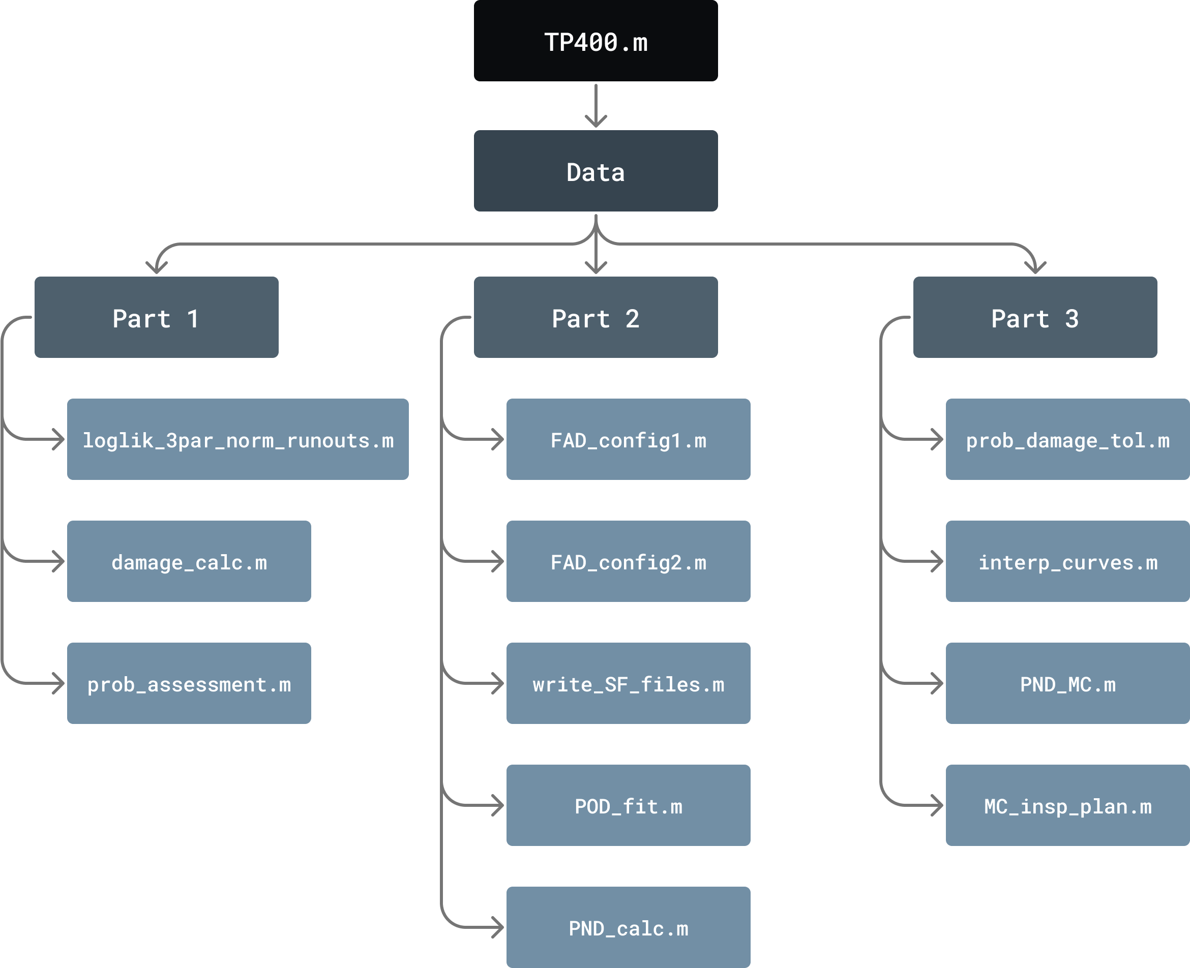
1
1.4
Introduction
Code Structure
8
Nikolaos Rigatos, Structural Reliability of Aerospace Components, AY 2023/24

Slide 9

Titolo presentazione sottotitolo
Part 1
Safe-life Assessment
Milano, XX mese 20XX

Slide 10
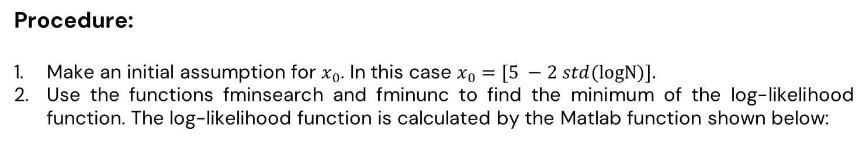
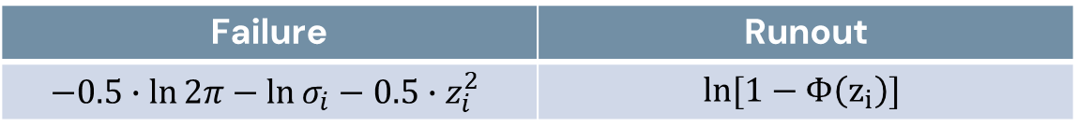
2
2.1
Results: Part 1
Task 1.1
10
Procedure:
Make an initial assumption for $x_{0}$. In this case $x_{0}=[5 −2 std(\text{logN}\text{)].}$
Use the functions fminsearch and fminunc to find the minimum of the log-likelihood function. The log-likelihood function is calculated by the Matlab function shown below:
Where the loglik function values are calculated according to:
Failure | Runout
$$−0.5∙\ln{2π}−\ln{σ_{i}−0.5∙z_{i}^{2}}$$ | $$\ln{[1−Φ\left(z_{i}\right)]}$$
Nikolaos Rigatos, Structural Reliability of Aerospace Components, AY 2023/24

Slide 11
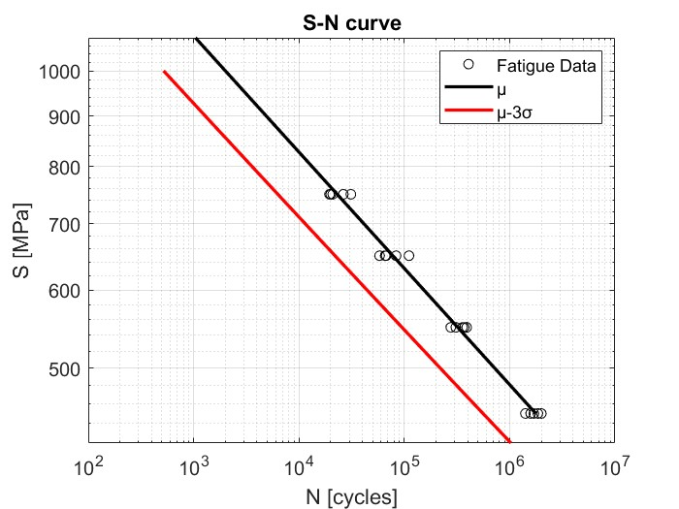
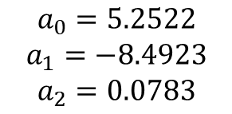
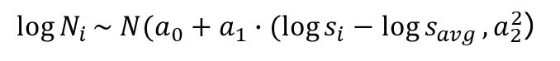
2
2.1
Results: Part 1
Task 1.1
11
Parameters of the model:
$$a_{0}=5.2522$$
$$a_{1}=−8.4923$$
$$a_{2}=0.0783$$
Therefore:
$\log{N_{i}}\sim N(a_{0}+a_{1}∙(\log{s_{i}}−\log{s_{avg}}, a_{2}^{2}$)
Nikolaos Rigatos, Structural Reliability of Aerospace Components, AY 2023/24

Slide 12
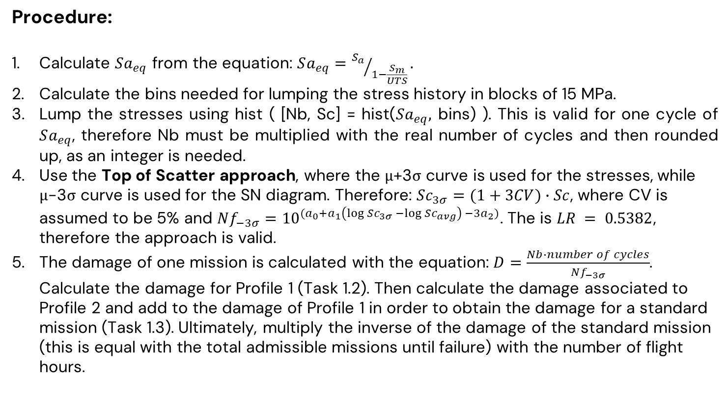
2
2.2
Results: Part 1
Task 1.2, 1.3, 1.4
12
Procedure:
Calculate $Sa_{eq}$ from the equation: $Sa_{eq}={S_{a}}/{1−\frac{S_{m}}{UTS}}.$
Calculate the bins needed for lumping the stress history in blocks of 15 MPa.
Lump the stresses using hist ( [Nb, Sc] = hist($Sa_{eq},$ bins) ). This is valid for one cycle of $Sa_{eq}$, therefore Nb must be multiplied with the real number of cycles and then rounded up, as an integer is needed.
Use the Top of Scatter approach, where the μ+3σ curve is used for the stresses, while μ-3σ curve is used for the SN diagram. Therefore: $Sc_{3σ}=(1+3CV)∙Sc$, where CV is assumed to be 5% and $Nf_{−3σ}={10}^{(a_{0}+a_{1}\left(\log{Sc_{3σ}} −\log{Sc_{avg}}\right) −3a_{2})}$. The is $LR = 0.5382$, therefore the approach is valid.
The damage of one mission is calculated with the equation: $D=\frac{Nb∙number of cycles}{Nf_{−3σ}}$. Calculate the damage for Profile 1 (Task 1.2). Then calculate the damage associated to Profile 2 and add to the damage of Profile 1 in order to obtain the damage for a standard mission (Task 1.3). Ultimately, multiply the inverse of the damage of the standard mission (this is equal with the total admissible missions until failure) with the number of flight hours.
Nikolaos Rigatos, Structural Reliability of Aerospace Components, AY 2023/24
Parcelj Antonio, Rigatos Nikolaos Aerostructures design and testing, AY 2023/24

Slide 13
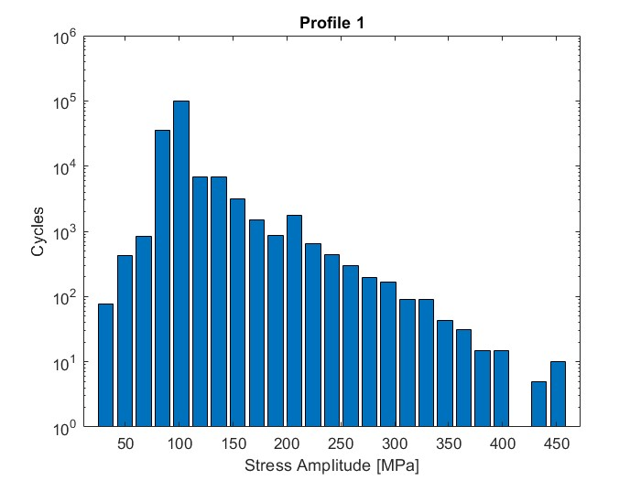
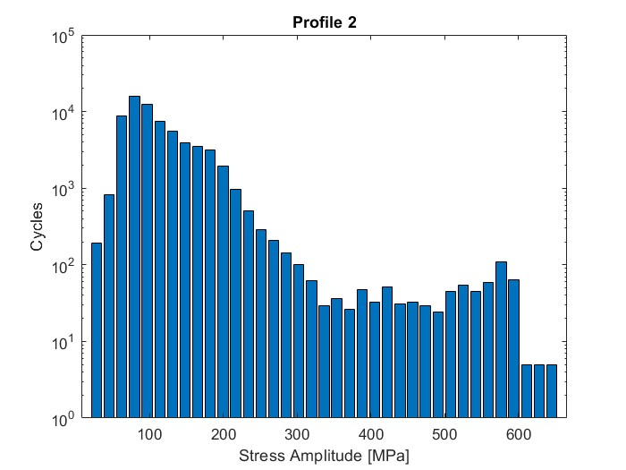
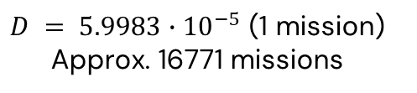
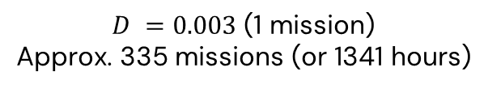
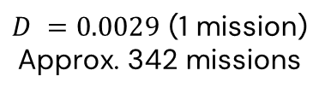
2
2.2
Results: Part 1
Tasks 1.2, 1.3, 1.4
13
Profile 1
Profile 2
$D = 5.9983∙{10}^{−5}$ (1 mission)
Approx. 16771 missions
$D =0.0029$ (1 mission)
Approx. 342 missions
$D =0.003$(1 mission)
Approx. 335 missions (or 1341 hours)
Nikolaos Rigatos, Structural Reliability of Aerospace Components, AY 2023/24

Slide 14
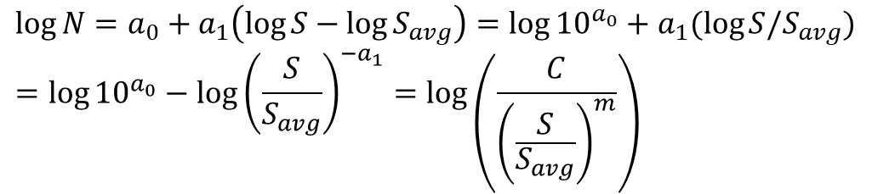
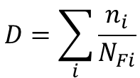
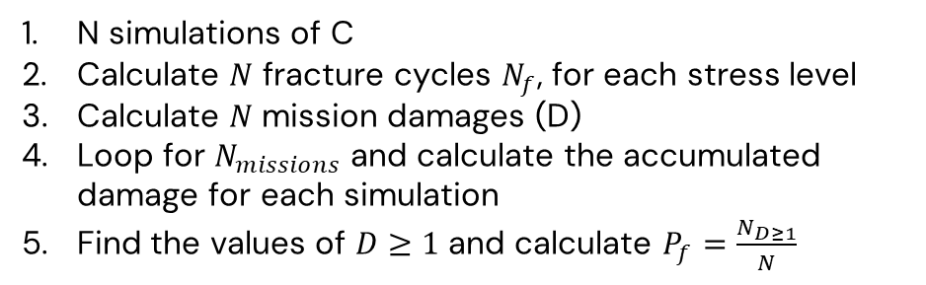

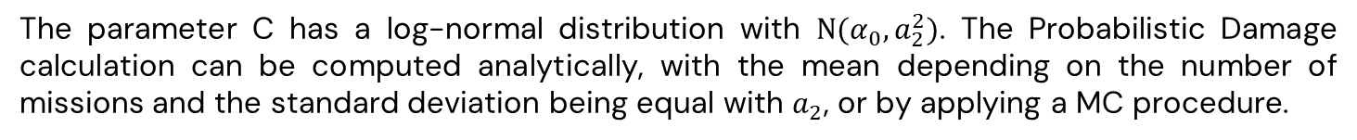
2
2.3
Results: Part 1
Task 1.5
14
$$D=\sum_{i}{\frac{n_{i}}{N_{Fi}}}$$
$$\log{N}=a_{0}+a_{1}\left(\log{S}−\log{S_{avg}}\right)=\log{{10}^{a_{0}}}+a_{1}(\log{S/S_{avg})}=\log{{10}^{a_{0}}−\log{{\left(\frac{S}{S_{avg}}\right)}^{{−a}_{1}}}=\log\left(\frac{C}{{\left(\frac{S}{S_{avg}}\right)}^{m}}\right)}$$
and
The parameter C has a log-normal distribution with $Ν(α_{0}, a_{2}^{2})$. The Probabilistic Damage calculation can be computed analytically, with the mean depending on the number of missions and the standard deviation being equal with $a_{2}$, or by applying a MC procedure.
N simulations of C
Calculate $N$ fracture cycles $N_{f}$, for each stress level
Calculate $N$mission damages (D)
Loop for $N_{missions}$ and calculate the accumulated damage for each simulation
Find the values of $D≥1$ and calculate $P_{f}=\frac{N_{D≥1}}{N}$
$$D=\sum_{i}{\frac{n_{i}}{\frac{C}{{\left(\frac{S_{i}}{S_{avg}}\right)}^{m}}}}$$
Nikolaos Rigatos, Structural Reliability of Aerospace Components, AY 2023/24

Slide 15
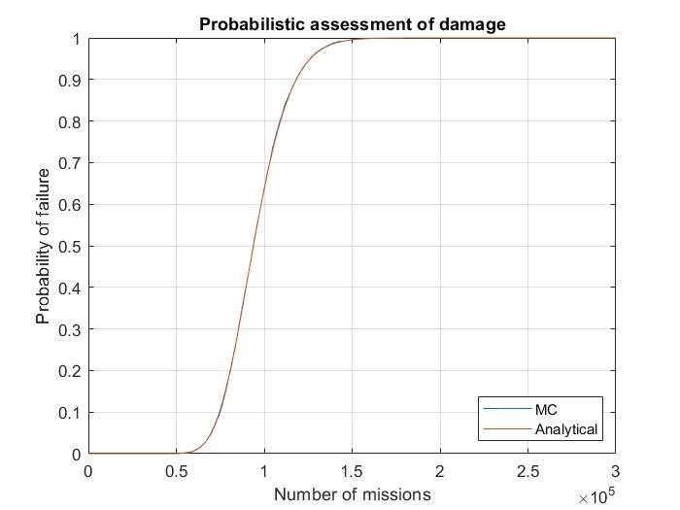
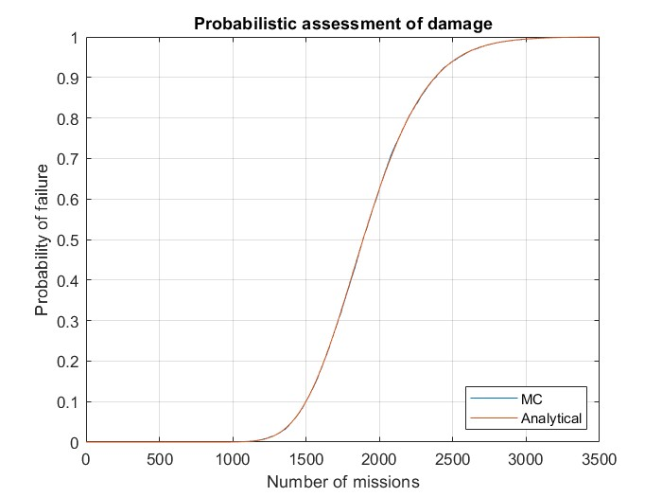
2
2.3
Results: Part 1
Task 1.5
15
Profile 1
Standard Mission
Nikolaos Rigatos, Structural Reliability of Aerospace Components, AY 2023/24

Slide 16
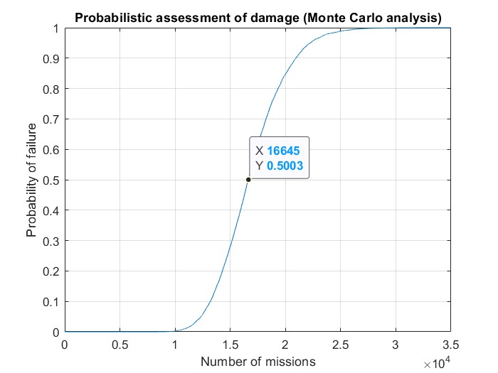
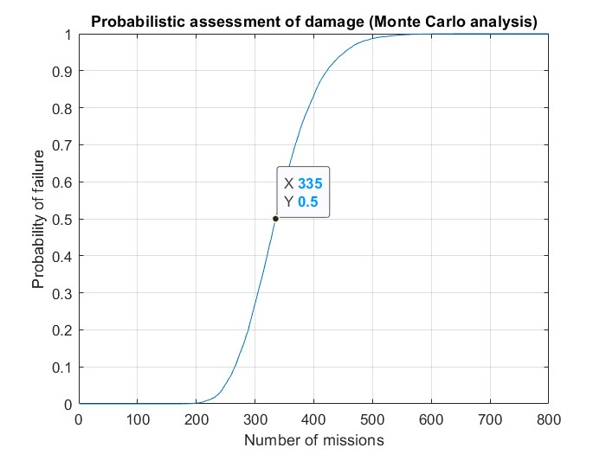
2
2.3
Results: Part 1
Task 1.5
16
Validation
Profile 1
Standard Mission
Nikolaos Rigatos, Structural Reliability of Aerospace Components, AY 2023/24

Slide 17
Titolo presentazione sottotitolo
Part 2
Deterministic Damage Tolerance Assessment
Milano, XX mese 20XX

Slide 18
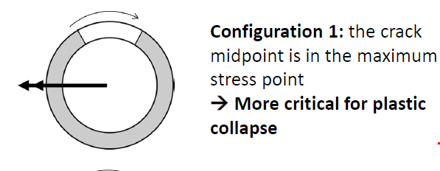
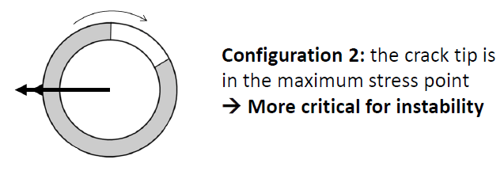
3
3.1
Results: Part 2
Task 2.1
18
Determine the critical crack size for the following configurations:
Approximated as a circumferential through-wall crack
Approximated as a plate
with a middle crack
The maximum stress of Profile 3 is used for the determination of the critical crack size, which corresponds to a bending moment of 70 kNm.
Nikolaos Rigatos, Structural Reliability of Aerospace Components, AY 2023/24

Slide 19
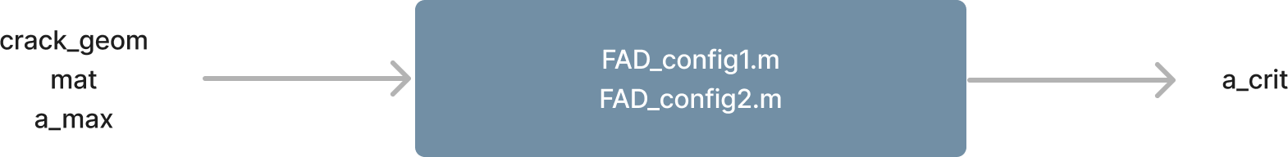
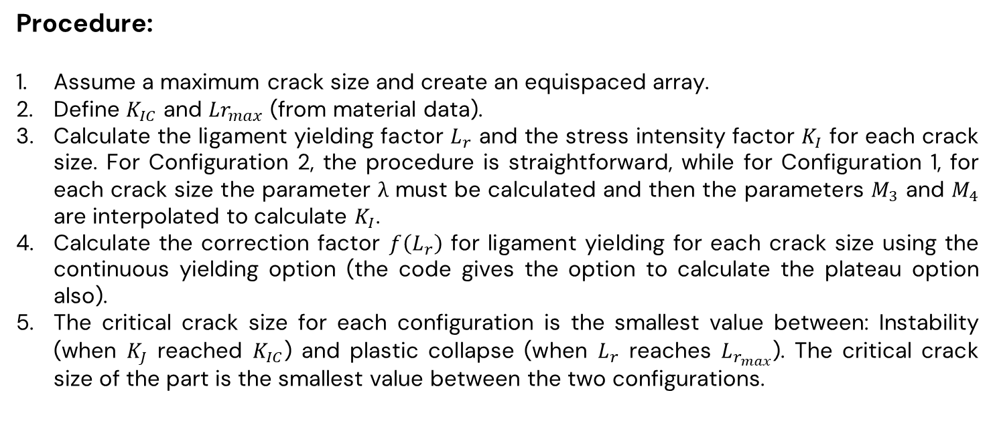
3
3.1
Results: Part 2
Task 2.1
19
Procedure:
Assume a maximum crack size and create an equispaced array.
Define $K_{IC}$ and $Lr_{max}$ (from material data).
Calculate the ligament yielding factor $L_{r}$ and the stress intensity factor $K_{I}$ for each crack size. For Configuration 2, the procedure is straightforward, while for Configuration 1, for each crack size the parameter λ must be calculated and then the parameters $M_{3}$ and $M_{4}$ are interpolated to calculate $K_{I}$.
Calculate the correction factor $f\left(L_{r}\right)$ for ligament yielding for each crack size using the continuous yielding option (the code gives the option to calculate the plateau option also).
The critical crack size for each configuration is the smallest value between: Instability (when $K_{J}$ reached $K_{IC}$) and plastic collapse (when $L_{r}$ reaches $L_{r_{max}}$). The critical crack size of the part is the smallest value between the two configurations.
Nikolaos Rigatos, Structural Reliability of Aerospace Components, AY 2023/24

Slide 20
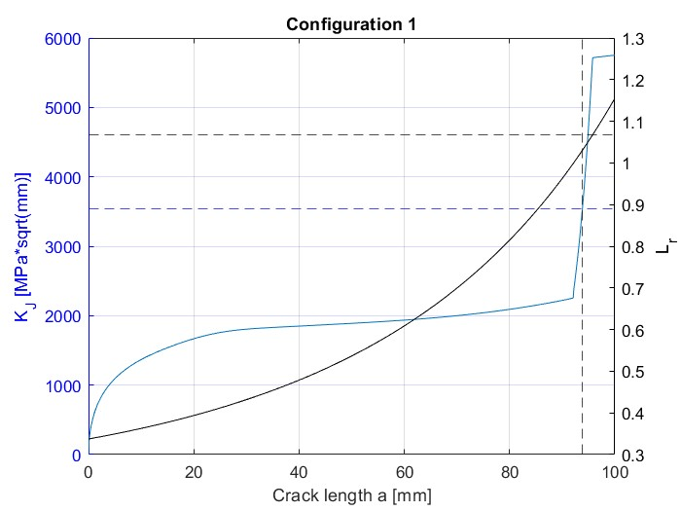
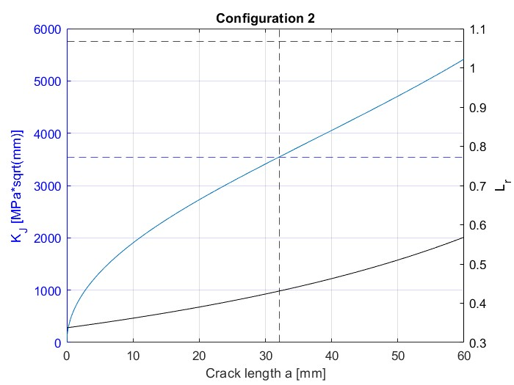
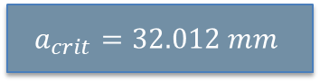
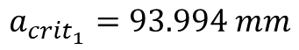
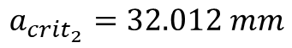
3
3.1
Results: Part 2
Task 2.1
20
$$a_{crit_{1}}=93.994 mm$$
$$a_{crit_{2}}=32.012 mm$$
$$a_{crit}=32.012 mm$$
Nikolaos Rigatos, Structural Reliability of Aerospace Components, AY 2023/24

Slide 21
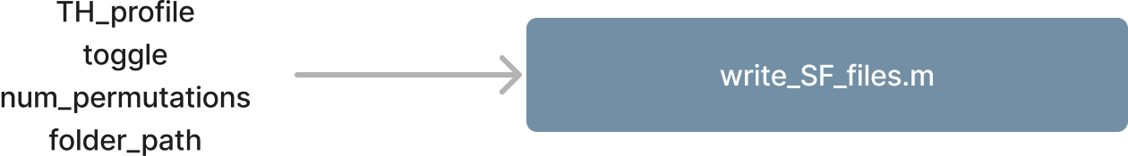
3
3.2
Results: Part 2
Tasks 2.2, 2.3
21
Procedure:
From the damage_calc.m function, the lumped stresses are available (note: The stresses used are the mean ones, not the ones used for the top of scatter approach).
The lumped signal is randomized 10 times and 10 SF files are created.
The lumped signal is inserted in NASGRO, considering an initial semi-circular defect of a=0.38mm and the maximum admissible crack from the previous task is used for the termination of the crack growth analysis. This is done for all SF files.
The load sequence with the least number of admissible missions is used for the following analysis (note: the load sequence didn’t affect the number of missions – but number of cycles).
Nikolaos Rigatos, Structural Reliability of Aerospace Components, AY 2023/24

Slide 22
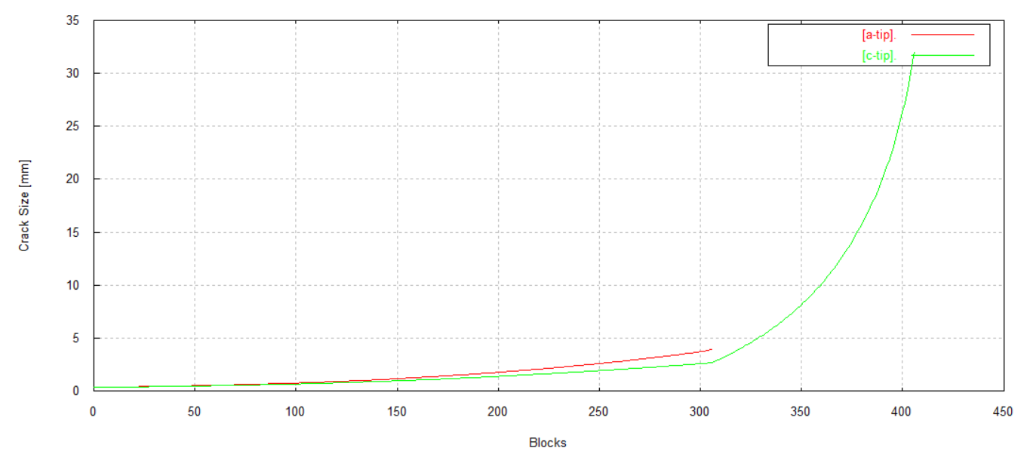
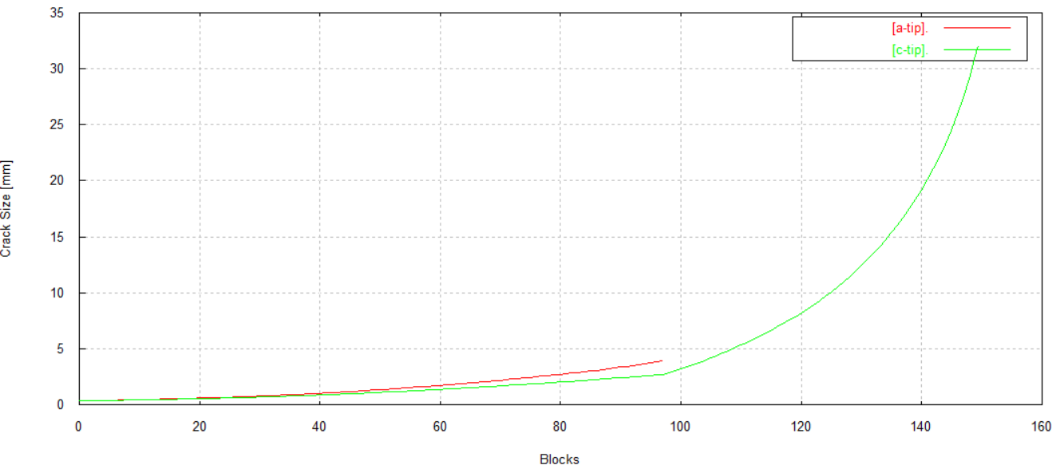
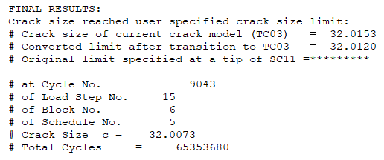
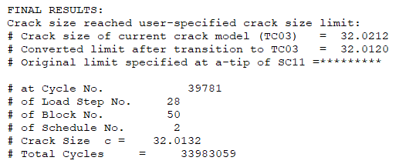
3
3.2
Results: Part 2
Tasks 2.2, 2.3
22
Profile 1
Standard Mission
Number of admissible missions:
406 (approx. 1218 hours)
Number of admissible missions:
150 (approx. 600 hours)
Nikolaos Rigatos, Structural Reliability of Aerospace Components, AY 2023/24

Slide 23
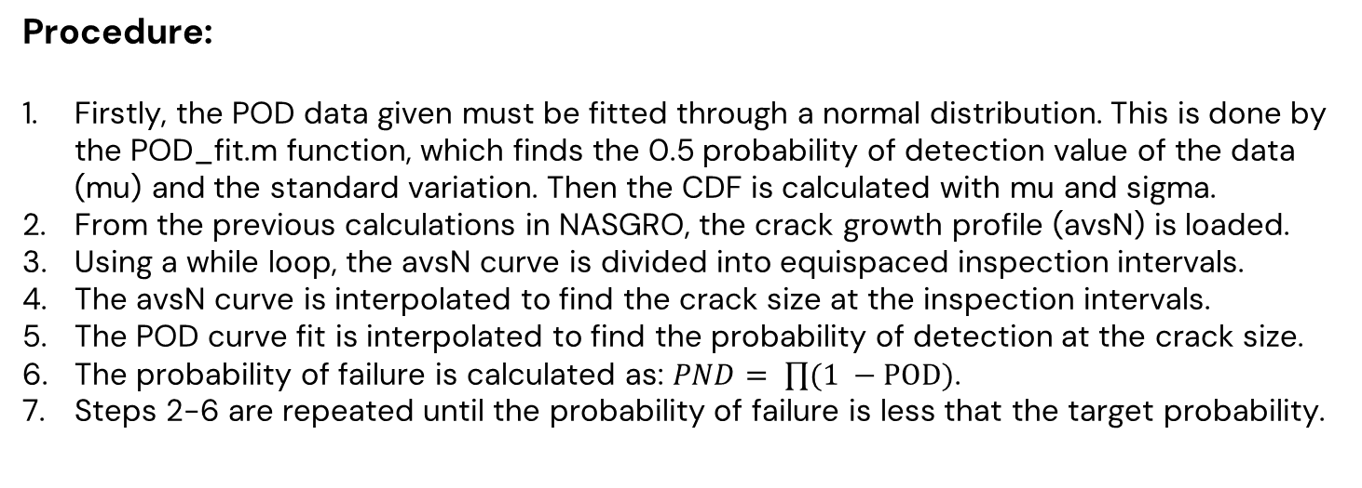
3
3.3
Results: Part 2
Task 2.4
23
Since the target life of 3000h is not met, inspections intervals should be defined to ensure a $P_{f}$ of 2e-5.
Procedure:
Firstly, the POD data given must be fitted through a normal distribution. This is done by the POD_fit.m function, which finds the 0.5 probability of detection value of the data (mu) and the standard variation. Then the CDF is calculated with mu and sigma.
From the previous calculations in NASGRO, the crack growth profile (avsN) is loaded.
Using a while loop, the avsN curve is divided into equispaced inspection intervals.
The avsN curve is interpolated to find the crack size at the inspection intervals.
The POD curve fit is interpolated to find the probability of detection at the crack size.
The probability of failure is calculated as: $PND= \prod{(1 −POD)}$.
Steps 2-6 are repeated until the probability of failure is less that the target probability.
Nikolaos Rigatos, Structural Reliability of Aerospace Components, AY 2023/24

Slide 24
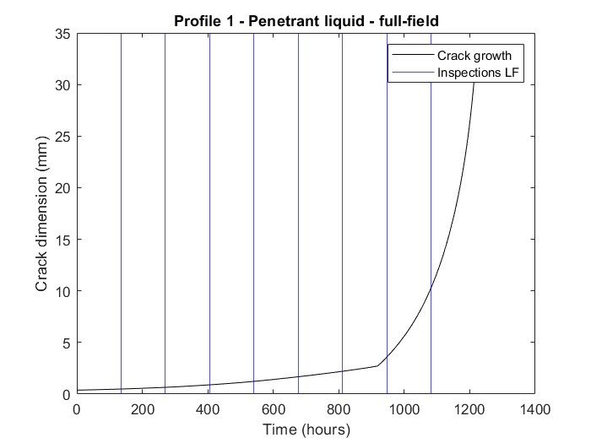
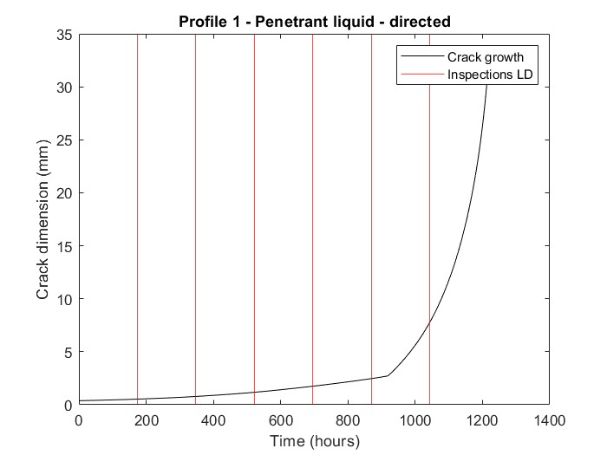
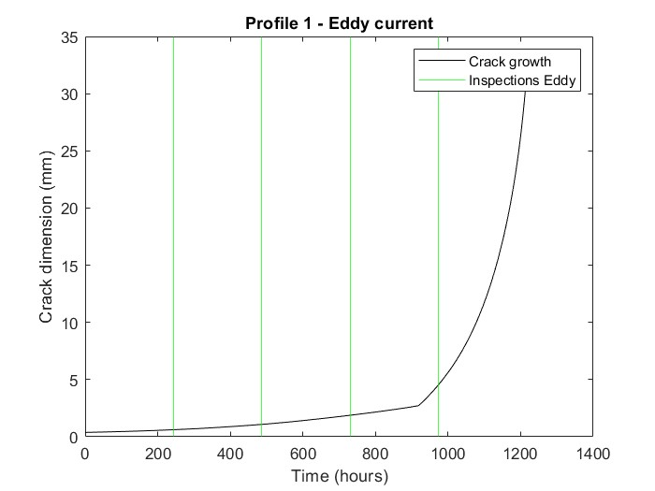
3
3.3
Results: Part 2
Task 2.4
24
Profile 1
Penetrant liquid: full field
Penetrant liquid: directed
Eddy current
Inspection interval:
135.25 hours
Inspection interval:
173.90 hours
Inspection interval:
243.46 hours
Nikolaos Rigatos, Structural Reliability of Aerospace Components, AY 2023/24

Slide 25
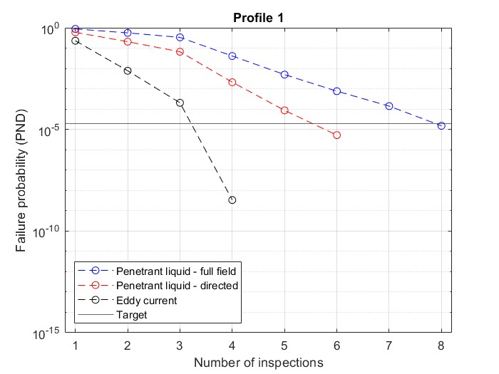
3
3.3
Results: Part 2
Task 2.4
25
Profile 1
Nikolaos Rigatos, Structural Reliability of Aerospace Components, AY 2023/24

Slide 26
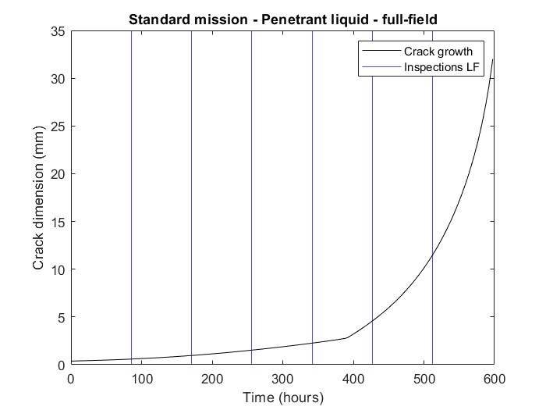
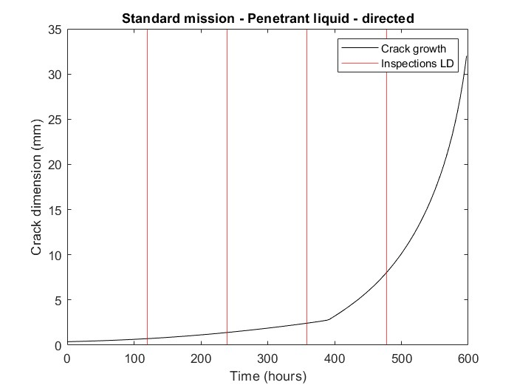
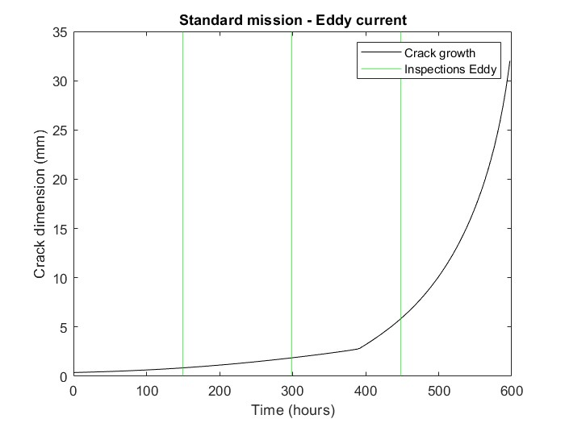
3
3.3
Results: Part 2
Task 2.4
26
Standard Mission
Penetrant liquid: full field
Penetrant liquid: directed
Eddy current
Inspection interval:
85.36 hours
Inspection interval:
119.50 hours
Inspection interval:
149.38 hours
Nikolaos Rigatos, Structural Reliability of Aerospace Components, AY 2023/24

Slide 27
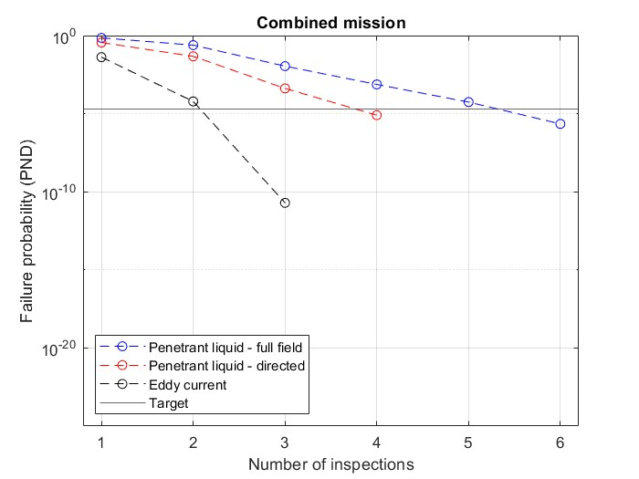
3
3.3
Results: Part 2
Task 2.4
27
Standard Mission
Nikolaos Rigatos, Structural Reliability of Aerospace Components, AY 2023/24

Slide 28
Titolo presentazione sottotitolo
Part 3
Probabilistic Damage Tolerance Assessment
Milano, XX mese 20XX

Slide 29
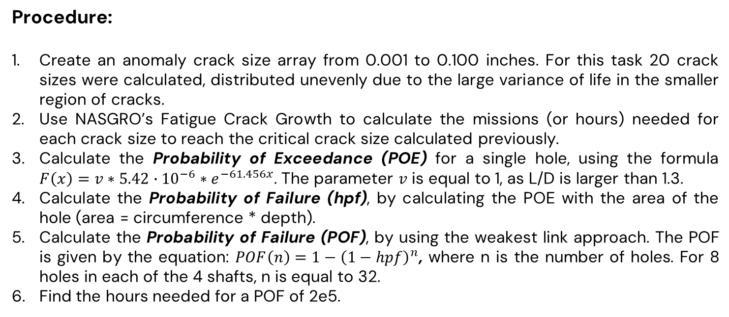
4
4.1
Results: Part 3
Task 3.1
29
Procedure:
Create an anomaly crack size array from 0.001 to 0.100 inches. For this task 20 crack sizes were calculated, distributed unevenly due to the large variance of life in the smaller region of cracks.
Use NASGRO’s Fatigue Crack Growth to calculate the missions (or hours) needed for each crack size to reach the critical crack size calculated previously.
Calculate the Probability of Exceedance (POE) for a single hole, using the formula $F\left(x\right)=v∗5.42∙{10}^{−6}∗e^{−61.456x}$. The parameter $v$ is equal to 1, as L/D is larger than 1.3.
Calculate the Probability of Failure (hpf), by calculating the POE with the area of the hole (area = circumference * depth).
Calculate the Probability of Failure (POF), by using the weakest link approach. The POF is given by the equation: $POF\left(n\right)=1−{\left(1−hpf\right)}^{n}$, where n is the number of holes. For 8 holes in each of the 4 shafts, n is equal to 32.
Find the hours needed for a POF of 2e5.
Nikolaos Rigatos, Structural Reliability of Aerospace Components, AY 2023/24

Slide 30
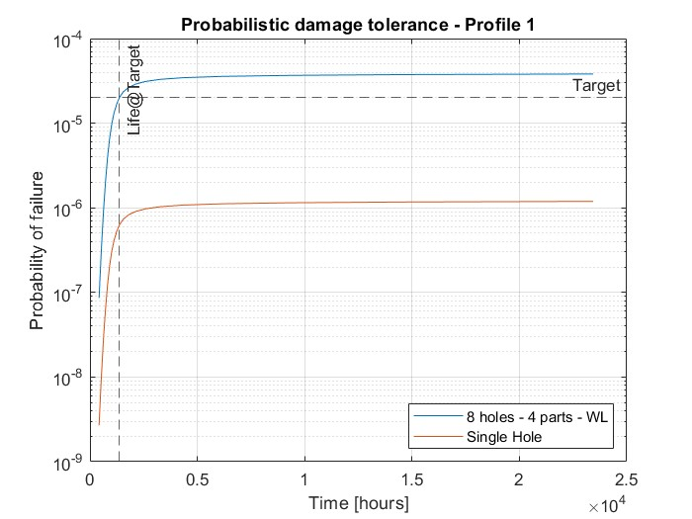
4
4.1
Results: Part 3
Task 3.1
30
Profile 1
The life with a probability of being exceeded of 2e-5 is:
1367.9 hours
Nikolaos Rigatos, Structural Reliability of Aerospace Components, AY 2023/24

Slide 31
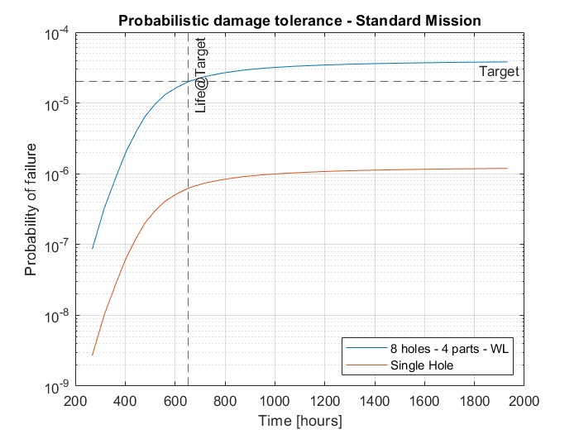
4
4.1
Results: Part 3
Task 3.1
31
Standard Mission
The life with a probability of being exceeded of 2e-5 is:
652.7 hours
Nikolaos Rigatos, Structural Reliability of Aerospace Components, AY 2023/24

Slide 32
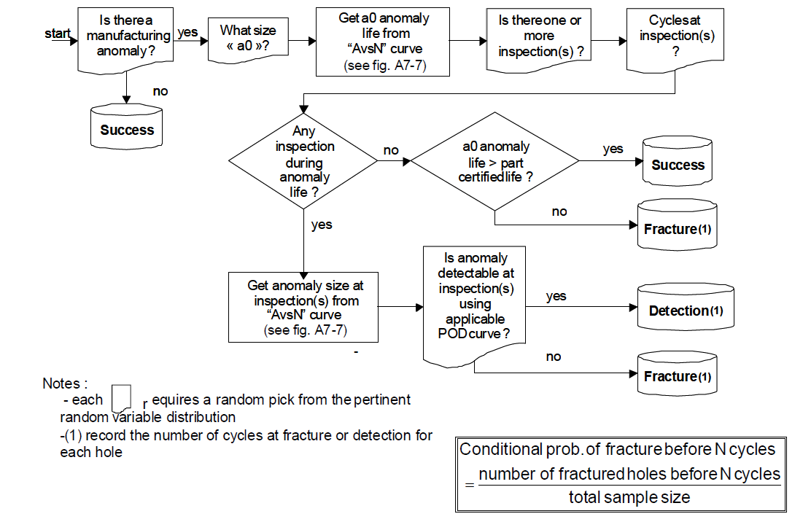
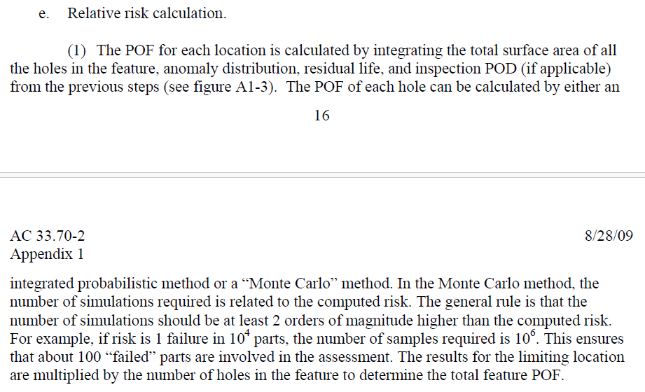
4
4.2
Results: Part 3
Task 3.2
32
AC 33-70.2
Nikolaos Rigatos, Structural Reliability of Aerospace Components, AY 2023/24

Slide 33

4
4.2
Results: Part 3
Task 3.2
33
Exponential distribution
$$N(t_{insp},{t_{insp}0.033}^{2})$$
Interpolate the curves calculated from NASGRO
for the initial defect size
Failure if there is no detection at any inspection interval
Nikolaos Rigatos, Structural Reliability of Aerospace Components, AY 2023/24

Slide 34

4
4.2
Results: Part 3
Task 3.2
34
Profile 1 (1e5 simulations)
Nikolaos Rigatos, Structural Reliability of Aerospace Components, AY 2023/24

Slide 35
5
5.1
Conclusions
Comparison
35
Profile | Part 1 [hours] | Part 2 [hours] | Part 3 [hours]
Profile 1 | 50313 | 1218 | 1367.9
Standard Mission | 1341 | 600 | 652.7
Part 1, which considers no anomalies in the parts, has the least conservative approach, with a big deviation in the calculated life relative to Part 2, Part 3.
Part 2 is a deterministic damage tolerance analysis, which considers an initial defect presence in the part. In essence, the initial defect is the average defect size given in Part 3. The approach seems much more reliable than Part 1, but ultimately is a little more conservative than Part 3. This is because in Part 3 all the entire initial defect domain is considered, which has more cracks distributed to the lower end (exponential distribution).
Nikolaos Rigatos, Structural Reliability of Aerospace Components, AY 2023/24

